Slide 1

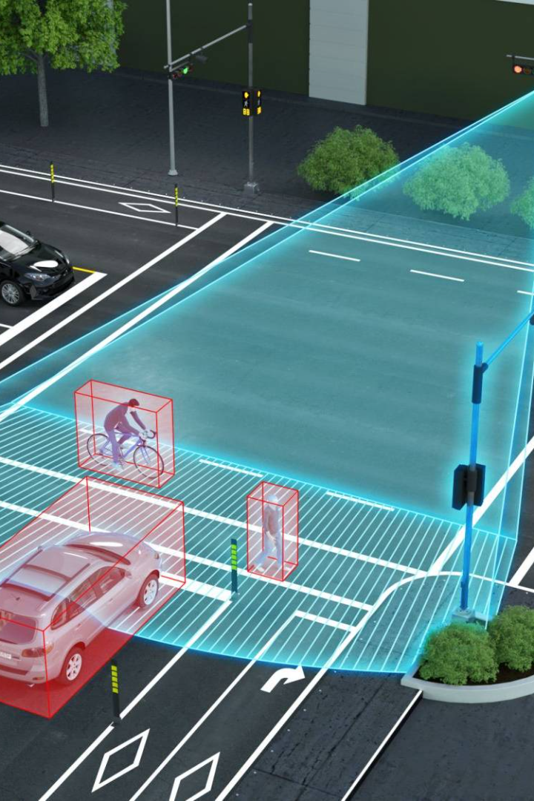
Traffic Management using IoT
Discover the game-changing potential of IoT technologies in traffic management and how they can enhance traffic control, monitoring, and analysis.

Slide 2
Overview of IoT in Traffic Management
1
IoT Defined
Explore the basics of IoT and the concepts behind it, and its applications in traffic management.
IoT in Action
2
Learn how IoT has revolutionized traffic management by improving real-time data collection, traffic monitoring, and emergency response systems.
3
Challenges of IoT
Examine the current challenges of implementing IoT in traffic management, including cost, privacy, and regulatory issues.

Slide 3
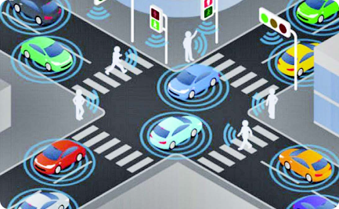
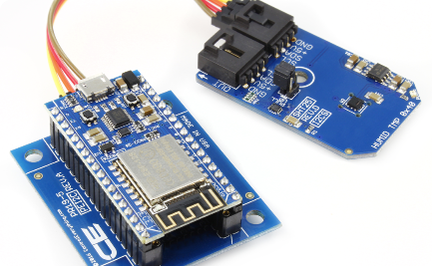
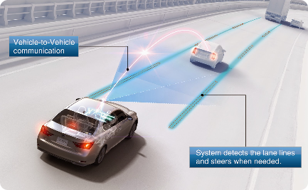
Key IoT Technologies for Traffic Management
Intelligent Traffic Lights
Sensor Networks
V2X Communication
Learn how smart traffic lights use machine learning and sensor data to optimize traffic flow and reduce congestion.
Discover how IoT sensors can be used to collect real-time traffic data and enable intelligent traffic control systems.
Find out how vehicle-to-everything (V2X) communication enables vehicles and infrastructure to exchange real-time traffic data.

Slide 4
Real-time Data Collection and Processing with IoT
IoT-enabled Data Collection
Big Data Analytics
Cloud Computing
Learn how machine learning and big data analytics can process and analyze traffic data to provide insights for better traffic management.
Discover how cloud computing enables real-time processing and analysis of traffic data across multiple locations.
Discover how IoT sensors, cameras, and drones provide real-time data for traffic management.

Slide 5
Intelligent Traffic Control using IoT
1
Smart Traffic Signals
Learn how intelligent traffic signals can adjust to traffic conditions in real-time, reducing congestion and emissions.
2
Adaptive Traffic Routing
Discover how IoT can enable real-time adaptive routing based on traffic conditions and incidents.
3
Emergency Response
Find out how IoT can improve emergency response times by providing real-time alerts and data to emergency services.

Slide 6
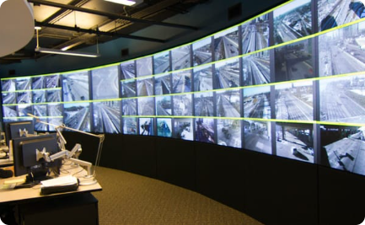
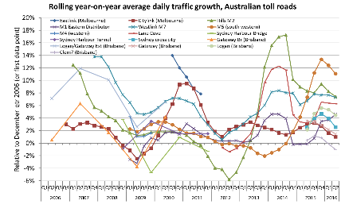
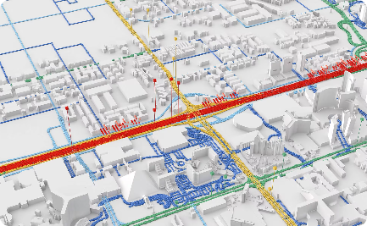
IoT-based Traffic Monitoring and Analysis
Traffic Monitoring
Traffic Analysis
Real-time Traffic Maps
Learn how IoT technologies enable real-time traffic monitoring and incident detection.
Discover how big data and machine learning can provide insights into traffic patterns, congestion, and emissions.
Find out how real-time traffic maps provide real-time information to drivers about traffic conditions and alternative routes.

Slide 7

Benefits of Using IoT in Traffic Management
1
Improved Traffic Flow
2
Real-time Incident Management
Reduced congestion, better traffic control, and less environmental impact.
Quick response to incidents and accidents, and better emergency services management.
3
Big Data Insights
Insights into traffic patterns, utilization, driving behavior, and emissions to inform policy-making.

Slide 8
Future Trends and Challenges in IoT-based Traffic Management
Connected Vehicles
Sustainability
Data Privacy and Security
Explore how connected vehicles will change traffic management and enable automated driving.
Find out how IoT technologies can help reduce emissions and improve energy efficiency in traffic management.
Examine the privacy and security challenges of IoT-based traffic management and how they can be addressed.

Slide 9

Conclusion: The Future of IoT-based Traffic Management
In conclusion, IoT has revolutionized the way we manage traffic, offering innovative solutions to address challenges and improve efficiency. As technology continues to advance, we can expect even more exciting developments in the field, paving the way for smarter and safer cities.

